Slide 1
SOC it to me: how to blueprint AI security governance using the tools you have
Mona Ghadiri | Microsoft MVP, Security | VP, Capgemini | monaghadiri.com

Slide 2

Mona Ghadiri
Microsoft MVP | Security
VP @ Capgemini — Cloud & Infrastructure, Security Operations
Likes Security Things
monaghadiri.com
Connect with me on LinkedIN

Slide 3
The Problem: We Are Moving Very Fast and Breaking Things
Organizations are rushing to deploy AI agents, copilots, and automated workflows.
The industry is obsessed with shiny tools. Governance frameworks are an afterthought.
AI capabilities are accelerating faster than the processes designed to control them.

Slide 4
New Attack Surfaces + Supply Chain + Prompt injection vuln example
Developer tools for power platform and AI integrations with them just allowed a novel C2 exploitation
Supply chain attack via AI agent integration
Supply Chain Attack via AI Agent Integration
Attackers injected malicious libraries into Visual Studio utilities used for Power Platform AI development, deploying the SesameOp backdoor.
Technique: Misused OpenAI Assistants API for covert command-and-control
Impact: Long-term persistence and espionage in AI development environments
Initial Compromise
Deployment
Exploitation
SesameOp backdoor
Deployed in Power Platform AI environment
Malicious libraries
Injected into Visual
Studio utilities
SesameOp backdoor
Deployed in Power
Platform AI
environment
Misuse of OpenAI
Assistants API for
Convert C2
Long-term
Persistence and
espionage
Attackers compromise
development tools
Backdoor installed for persistence
Attackers establish command-and-control channel
Data exfiltration and monitoring of AI workflows
SesameOp: Novel backdoor uses OpenAI Assistants API for command and control | Microsoft Security Blog
4

Slide 5
The Guardrails Trap and AI Governance
"Just add guardrails" is not a governance strategy.
Example: cars come with seatbelts
Guardrails are point controls. Governance is a framework.
Example: Seatbelts work well with windshield wipers and headlamps when its raining
You can have every guardrail in place and still have zero accountability unless there is an audit function.
Example: Even if you’re wearing your seatbelt, if you’re speeding, the cops will pull you over.

Slide 6
What AI Governance Actually Covers
Risk Ownership
Change Control
Who is accountable when an AI decision causes harm?
How are model updates, prompt changes, and new agents approved?
Data Governance
Access Control
What data is the model trained on, and who approved it?
Who can invoke AI agents, and with what permissions?
Audit & Logging
Incident Response
Can you trace every AI action back to a human decision point?
What happens when the AI makes a bad call at 2am?

Slide 7

AI is a system: how to define the AI Attack Surface
Training Data
The environment the agent is deployed in
Users
Apps
Models
The attack surface isn’t a single thing. We are suffering from the “blind men and the elephant” parable

Slide 8
Storyline
01
AI Supply-Chain Vulnerabilities:
02
Data Leakage via Prompts and Outputs
03
New Infrastructure Attack Surfaces
The use of third-party and open-source models creates exposure to tampered weights, malicious dependencies, and unclear model provenance.
LLMs can inadvertently reveal sensitive data or be manipulated through prompt injection from emails or documents. As AI tools touch operational workflows, strong guardrails are required to prevent leakage of PCI, PII, or confidential client information.
GPU clusters, vector databases, and agent runtimes introduce attack surfaces not fully covered by traditional cyber baselines.

Slide 9




Mapping the 3 use cases to multiple risk frameworks
All 3 use cases map across all risk taxonomies: OWASP top 10, NIST AI RMF, and EU AI Act
Gen AI-specific risk
3
3
AI-specific risk
Model Layer (3)
Training Data Layer (3)
App Layer (2)
User Layer (2)
Pre-trained base model/LLM
Training Data (Public)
2
Prompt input
Internal/
Vector
Database
2
Takeaways:
Selection of frameworks and use cases must be overlaid by personas
Use cases and log sources can be added to SIEM based on future roadmaps
User/Interface
1
1.Input Data Leakage
Libraries/
Pulgins
Response
Chat History
6.Promotion Injection
Fine-tuned model/LLM
Training Data & Fine-Tuning Data (internal or public domain)
System Prompt
RAG data
7.Denial of service
12.Supply Chain
15.Data Poisoning
2.Output Data Leakage
8.Excessive Permission
9.Unauthorized Retrieval
13.Model Drift
3.Overreliance
16.Training Data Leakage
4.Biased, harmful or inappropriate content
10.Supply Chain
14.Model Theft
11.Data Leakage
5.Hallucination
End-user
Deployer
Provider

Slide 10
You Are More Ready Than You Think
Your existing security tools — Sentinel, Defender, Purview, Entra ID — are really all parts of a connected elephant already built for this.
The controls we use for cloud workloads apply directly to AI workloads. Zero trust is relevant for AI workloads and many pieces are included in your E5 license.
Most organizations are starting from a stronger position than they realize.
Defender for Cloud reduces MCP exposure.
Sentinel exposes MCP misuse.
What’s missing? Governance assigns accountability.

Slide 11




Recommended Security Monitoring for Gen AI Security Architecture with Microsoft Security for Power Platform
Security Monitoring Blueprint
Best Practices
Monitoring Power Platform Usage
Enable Microsoft Defender for Cloud Apps to continuously monitor Power Platform activities and detect suspicious behavior effectively.
Anomaly Detection with Sentinel
Configure Microsoft Sentinel analytics rules to identify unusual activities and potential threats within AI development workflows.
Custom Anomaly Policies
Set up tailored anomaly detection policies specific to AI workflows to proactively catch malicious behavior before damage occurs.
Access
control
Takeaways:
Multiple security use cases covered with security monitoring blueprint
Security monitoring requires logs from everywhere in green
IAM
Agent
App Layer
Function calling
Services (mail, website…)
Model Layer
Training Data Layer
Prompt guardrail
Pre-trained large language model
Pre-trained dataset
Prompt input
Libraries
Chat history
Fine-tuned large language model
Fine tuning dataset
Database
RAG data
System prompt
Logs:
Rejected
Prompt
injection
Logs: Security
Logs, Error logs
Scan for personal or biased training data
Logs:
User actions
Logs: Access logs
Logs: Security logs, Error logs
Log collector
Alerting & monitoring
SIEM

Slide 12
Couple the threat with the tools
Map where human judgment is required vs. where automation is safe
Define the threat you are trying to mitigate
Fit the features from the Defender Stack
Identify the data sources you need and who owns them
Design the governance model: approval, logging, escalation, rollback

Slide 13
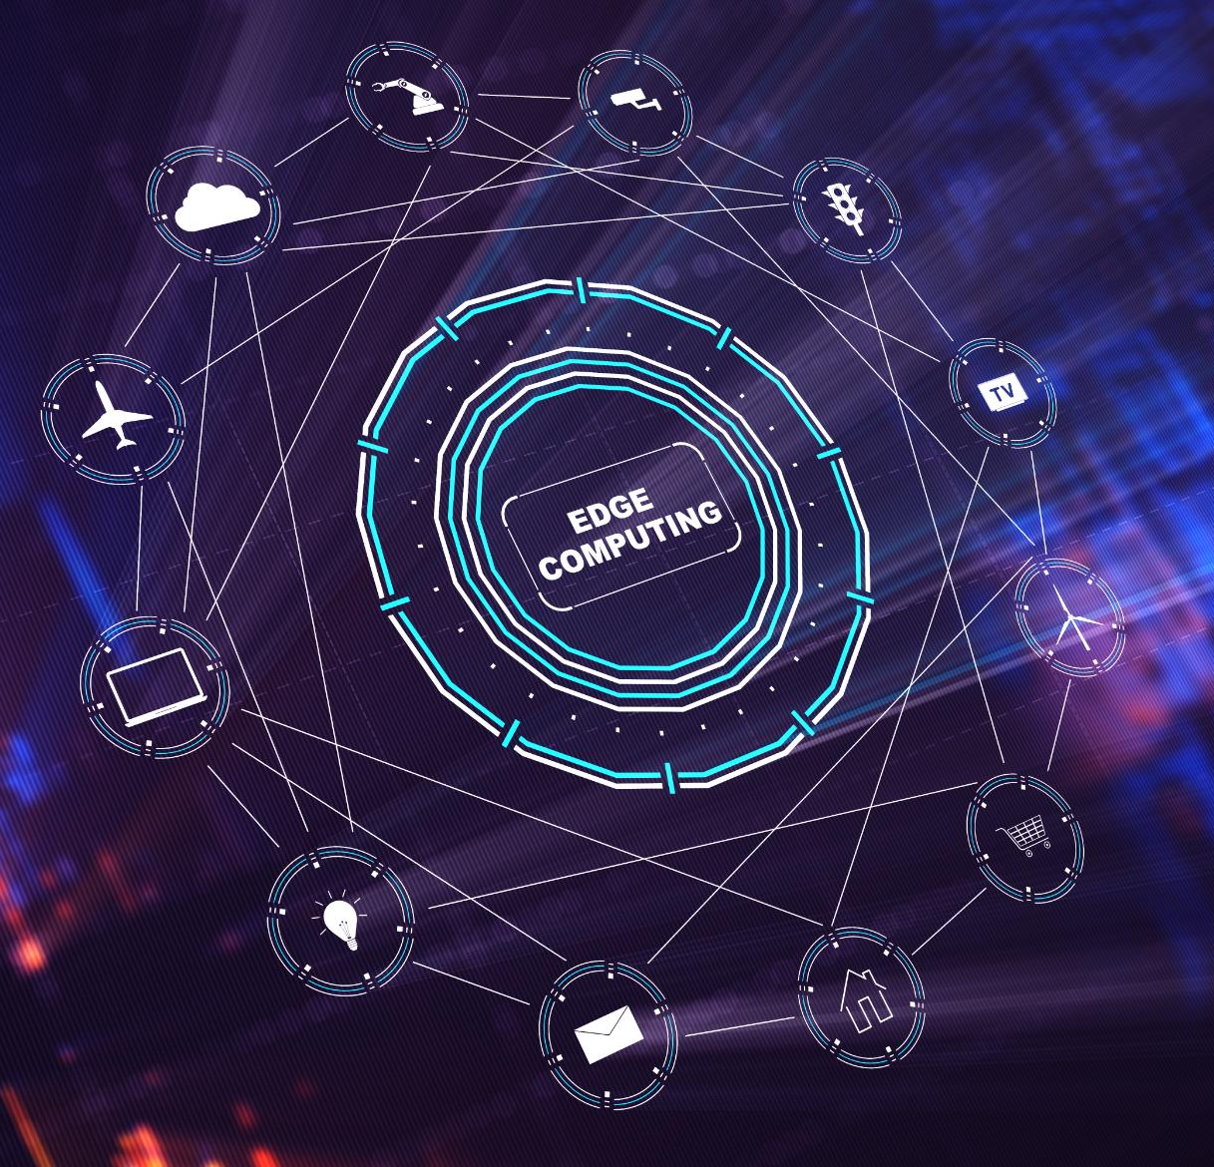
Mapping MCP Server Security Requirements to Microsoft Platforms
Identity and Access Control
Entra ID treats MCP servers as workload identities, enforcing conditional access and Zero Trust principles.
Exposure Management
Defender for Cloud and Security Exposure Management identify and mitigate risks from exposed MCP APIs and endpoints.
Detection and Response
Sentinel and Defender XDR provide centralized monitoring and cross-domain visibility for MCP-related security incidents.
Secrets Management
Azure Key Vault secures credentials and tokens with encrypted storage and identity-based access.
Notes:
Securing Model Context Protocol (MCP) servers requires deliberate application of enterprise-grade identity, exposure management, detection, response, and secrets protection controls. MCP servers act as orchestration layers between AI agents and sensitive enterprise tools or data, making them a powerful but high-risk integration point if left ungoverned. Microsoft’s security stack provides foundational capabilities that, when correctly configured, can significantly reduce MCP server risk even though MCP itself is not natively understood by these services. Identity and access control is the first defensive layer. Microsoft Entra ID enables organizations to treat MCP servers and AI agents as non-human workload identities rather than implicit trusted services. By applying Conditional Access for workload identities, organizations can restrict which service principals are allowed to authenticate, from which locations, and under what risk conditions. This aligns with Zero Trust principles by ensuring explicit verification and least privilege enforcement rather than assuming MCP traffic is inherently safe. Exposure management addresses the risk of MCP servers unintentionally exposing powerful internal APIs or tools. Microsoft Defender for Cloud and Microsoft Security Exposure Management provide continuous discovery and contextual risk insight into exposed cloud resources and attack paths. When MCP servers are treated as API gateways, these capabilities help organizations understand where MCP endpoints are reachable and how misconfigurations could lead to broader compromise across identities, data, or cloud workloads. Detection and response capabilities are essential due to the inherent non-determinism of AI agents. Microsoft Sentinel enables centralized ingestion and correlation of MCP server logs, API invocation telemetry, and identity signals. When combined with Microsoft Defender XDR, security teams gain cross-domain visibility that correlates MCP misuse with endpoint, identity, and cloud activity. This allows MCP-related abuse to be handled as privileged automation misuse rather than opaque AI behavior. Finally, secrets management ensures MCP servers never become a source of credential leakage. Azure Key Vault provides centralized, encrypted storage and access control for secrets, tokens, and API keys used by MCP-integrated tools. By integrating MCP servers with Key Vault and enforcing identity-based retrieval, organizations reduce the blast radius of token compromise and support rotation, auditing, and compliance requirements. Together, Entra ID, Defender for Cloud, Microsoft Sentinel, Defender XDR, and Azure Key Vault form a practical, defensible control framework for securing MCP servers. This approach avoids overstating product capabilities while enabling responsible and scalable use of MCP servers within modern AI environments.

Slide 14
Blueprint: Adapting Your Existing Stack for AI starts with the basics
Conditional Access
Microsoft Sentinel
Require compliant device and MFA for all users
Ingest AI audit logs; build detection rules for anomalous agent behavior
Audit Logging
Microsoft Purview
Enable Copilot interaction logging in Purview before going live
Apply DLP policies to AI outputs; classify data accessed by copilots
Change Management
Entra ID
Treat prompt library updates and agent config changes as code changes
Use PIM for AI agent identities; enforce least privilege on connectors
Incident Playbooks
Defender XDR
Write AI-specific IR runbooks before you need them, not after
Extend endpoint and identity signals to cover AI workload activity

Slide 15
Non negotiable basics: Securing AI in Production
Audit every plugin OAuth scope before enabling in production
Alert on anomalous agent behavior patterns in Sentinel
Purview audit logs for every Copilot interaction — no exceptions
Quarterly review of who has Copilot Owner and Contributor roles
Define max actions per session; no standing write permissions for agents
Maintain an approved prompt library; treat changes as code deployments

Slide 16
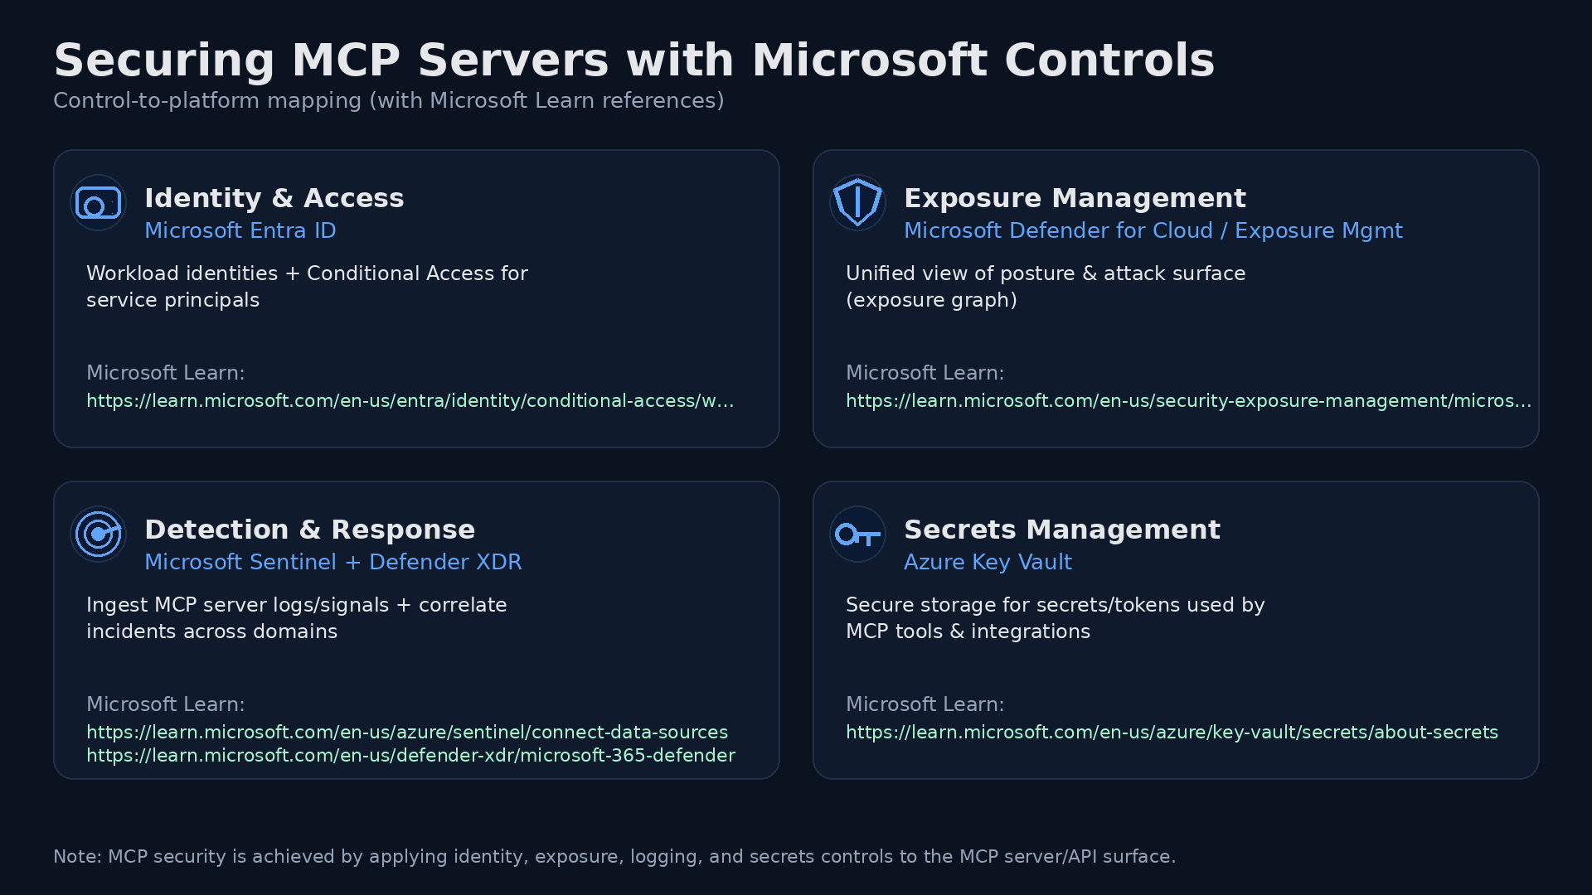
What do to next?
Zero Trust Workshop
AI | Microsoft Zero Trust
The Zero Trust workshop enabled the client to assess whether their environment was ready for MCP‑based AI automation by identifying where implicit trust, over‑privileged access, and limited validation would otherwise turn AI productivity into systemic risk.

